Slide 1
Exception Handling

Slide 2
Exception
  An unexpected and unwanted event that occurs during the execution of a program and disrupts the normal flow of the program is called an Exception.
  Exception = Runtime Error
  Example → ZeroDivisionError
Need of Exception Handling
  Exception handling is needed to:
    Prevent program crashes
    Handle errors gracefully
    Allow the program to continue running

Slide 3
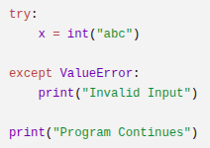


Slide 4
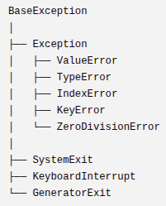
Exception Hierarchy
Exception hierarchy is the arrangement of all errors like a family tree (hierarchy).

Slide 5
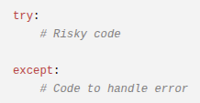
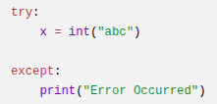
How to Handle Exceptions
To handle exceptions we use the try-except block.

Slide 6
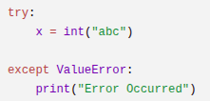
Proper Way of Handling Exceptions
Instead of catching every exception, catch the specific exception.

Slide 7
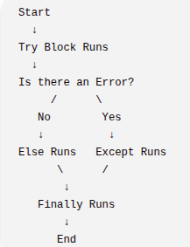
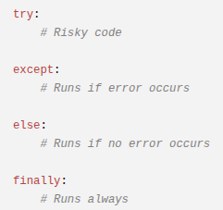
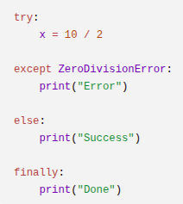
Exception Handling Structure

Slide 8
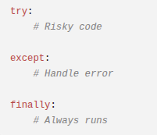
Finally Block
The finally block is the part of exception handling that always executes whether an exception occurs or not.
Uses of Finally Block
Used for cleanup work:
  Closing files
  Closing database connections
  Releasing resources

Slide 9
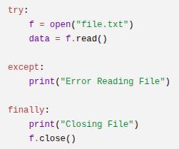
Scope Sharing
In Python, try, except, else, and finally all share the same scope.
Problem with the Above Code

Slide 10
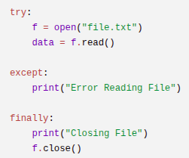
What if an error happens before f is created?
If the file does not exist.
UnboundLocalError
f was never assigned but finally is still trying to use it.

Slide 11
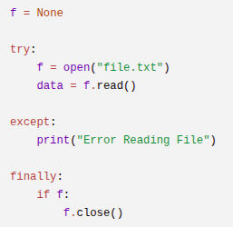
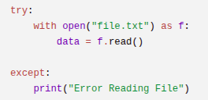
Advantage
Automatically closes the file
No need for finally

Slide 12
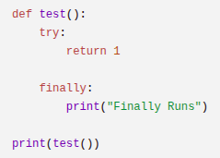
Special Case – Return and Finally
Even if a return statement is encountered, finally runs before returning.
What Happens Internally?
try block starts
return 1 is encountered
Python does NOT return immediately
Return value is stored temporarily
finally block executes
Stored value is returned
Why?
Because finally is meant for:
Cleanup
Releasing resources
Critical operations
Python guarantees:
"Before leaving, I will run finally no matter what."
If finally also contains a return, then it overrides the previous return.
Without finally, the function ends immediately when return is reached.

Slide 13
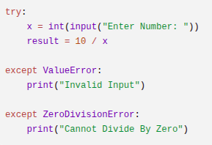
Multiple Except Blocks
Handling different types of errors separately using multiple except blocks.
Why?
Different errors need different handling.
Example:
  Wrong input → Show one message
  Divide by zero → Show another message

Slide 14
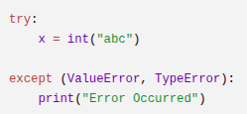
Catch Multiple Exceptions in One Block

Slide 15
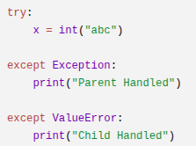
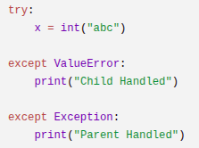
Parent vs Child Exception Concept
Child Exception
  More specific exception.
Parent Exception
  More general exception.
Python stops at the first matching exception block even if a better (more specific) match exists below.

Slide 16
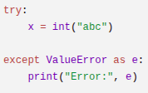
Using "as" in Exception Handling
Used to store the exception object in a variable so that you can access error details.
e holds the error message.

Slide 17

raise Keyword
Used to throw an exception manually.

Slide 18

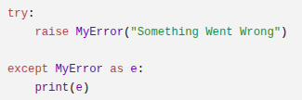
Custom Exception
A user-defined error that you create using a class to represent specific problems in your program.
Creating a Custom Exception
Step 1: Create a class inheriting from Exception
Step 2: Raise the exception

Slide 19

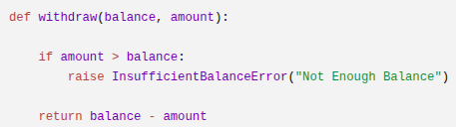
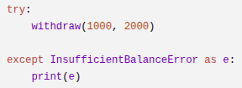

Slide 20
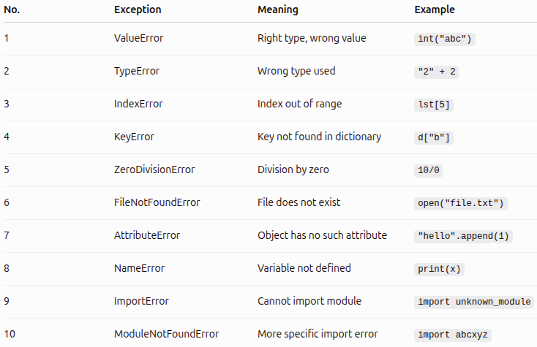
Most Important Exceptions

Slide 21
